Slide 1
Decision Tree
Iterative Dichotomiser 3 (ID3) Algorithm

Slide 2
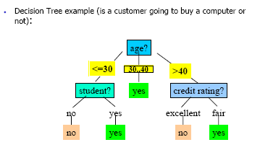
Basics
What is a decision tree?
A tree where each branching (decision) node represents a choice between 2 or more alternatives, with every branching node being part of a path to a leaf node
Decision node: Specifies a test of some attribute
Leaf node: Indicates classification

Slide 3
A decision tree is a hierarchical model for supervised learning whereby the local region is identified in a sequence of recursive splits in a smaller number of steps.
A decision tree is composed of internal decision nodes and terminal leaves.
Given an input, at each node, a test is applied and one of the branches is taken depending on the outcome.
This process starts at the root (i.e. root node) and is repeated recursively until a leaf node is hit, at which point the value written in the leaf constitutes the output.

Slide 4
ID3
Invented by J. Ross Quinlan
Employs a top-down greedy search through the space of possible decision trees.
Greedy because there is no backtracking. It picks highest values first.
Select attribute that is most useful for classifying examples (attribute that has the highest Information Gain).

Slide 5
ID3 Algorithm
1) Establish Classification Attribute (in Table R)
2) Compute Classification Entropy.
3) For each attribute in R, calculate Information Gain using classification attribute.
4) Select Attribute with the highest gain to be the next Node in the tree (starting from the Root node).
5) Remove Node Attribute, creating reduced table R_{S}.
6) Repeat steps 3-5 until all attributes have been used, or the same classification value remains for all rows in the reduced table or there are rows still available.

Slide 6

Entropy
Entropy measures the impurity of an arbitrary collection of examples.
For a collection S, entropy is given as:
For a collection S having positive and negative examples
Entropy(S) = -p₊log₂p₊ - p₋log₂p₋
where p₊ is the proportion of positive examples
and p₋ is the proportion of negative examples
In general, Entropy(S) = 0 if all members of S belong to the same class.
Entropy(S) = 1 (maximum) when all members are split equally.

Slide 7

Information Gain
Measures the expected reduction in entropy. The higher the IG, more is the expected reduction in entropy.
where Values(A) is the set of all possible values for attribute A,
S_{v} is the subset of S for which attribute A has value v.

Slide 8
Information Gain
Measures the expected reduction in entropy. The higher the IG, more is the expected reduction in entropy.
where Values(A) is the set of all possible values for attribute A,
S_{v} is the subset of S for which attribute A has value v.

Slide 9
Example 1 : Decision Tree Learning
Day
Outlook
Temperature
Humidity
Wind
PlayTennis
D1
Sunny
Hot
High
Weak
No
D2
Sunny
Hot
High
Strong
No
D3
Overcast
Hot
High
Weak
Yes
D4
Rain
Mild
High
Weak
Yes
D5
Rain
Cool
Normal
Weak
Yes
D6
Rain
Cool
Normal
Strong
No
D7
Overcast
Cool
Normal
Strong
Yes
D8
Sunny
Mild
High
Weak
No
D9
Sunny
Cool
Normal
Weak
Yes
D10
Rain
Mild
Normal
Weak
Yes
D11
Sunny
Mild
Normal
Strong
Yes
D12
Overcast
Mild
High
Strong
Yes
D13
Overcast
Hot
Normal
Weak
Yes
D14
Rain
Mild
High
Strong
No

Slide 10
Decision Tree Learning
Let
E([X+,Y-]) represent that there are X positive training elements and Y negative elements.
Therefore the Entropy for the training data, E(S), can be represented as E([9+,5-]) because of the 14 training examples 9 of them are yes and 5 of them are no.

Slide 11
Decision Tree Learning: A Simple Example
Let’s start off by calculating the Entropy of the Training Set.
E(S) = E([9+,5-]) = (-9/14 log₂ 9/14) + (-5/14 log₂ 5/14)
= 0.94

Slide 12
Decision Tree Learning: A Simple Example
Next we will need to calculate the information gain G(S,A) for each attribute A where A is taken from the set {Outlook, Temperature, Humidity, Wind}.

Slide 13
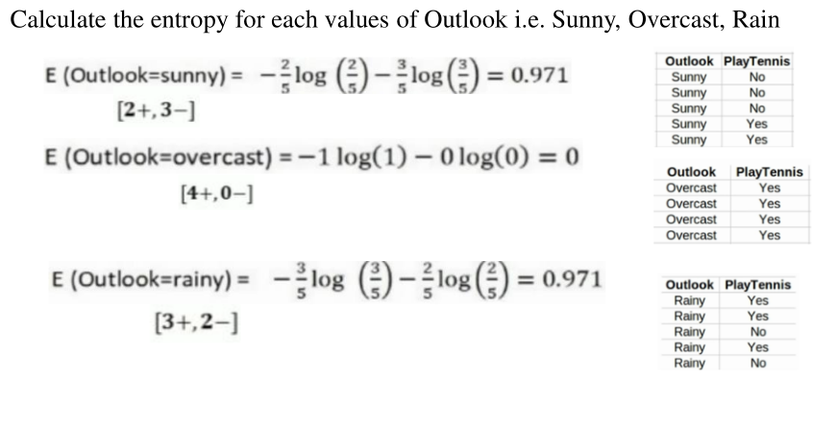
The information gain for Outlook is:
G(S,Outlook) = E(S) – [5/14 * E(Outlook=sunny) + 4/14 * E(Outlook = overcast) + 5/14 * E(Outlook=rain)]
G(S,Outlook) = E([9+,5-]) – [5/14*E(2+,3-) + 4/14*E([4+,0-]) + 5/14*E([3+,2-])]
G(S,Outlook) = 0.94 – [5/14*0.971 + 4/14*0.0 + 5/14*0.971]
G(S,Outlook) = 0.246

Slide 14
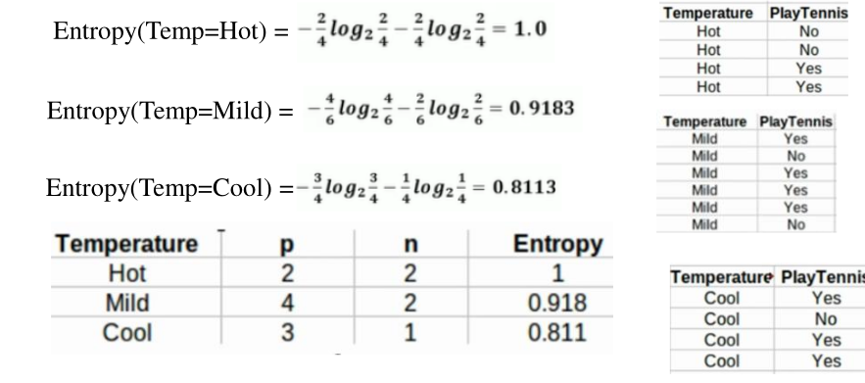
G(S,Temperature) = 0.94 – [4/14*E(Temperature=hot) + 6/14*E(Temperature=mild) + 4/14*E(Temperature=cool)]
G(S,Temperature) = 0.94 – [4/14*E([2+,2-]) + 6/14*E([4+,2-]) + 4/14*E([3+,1-])]
G(S,Temperature) = 0.94 – [4/14 + 6/14*0.918 + 4/14*0.811]
G(S,Temperature) = 0.029

Slide 15
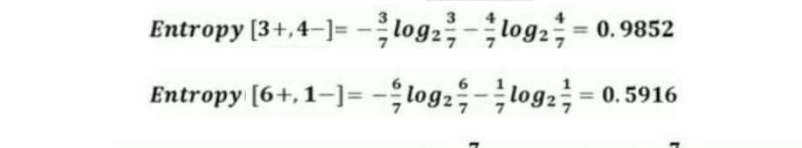
G(S,Humidity) = 0.94 – [7/14*E(Humidity=high) + 7/14*E(Humidity=normal)]
G(S,Humidity = 0.94 – [7/14*E([3+,4-]) + 7/14*E([6+,1-])]
G(S,Humidity = 0.94 – [7/14*0.985 + 7/14*0.592]
G(S,Humidity) = 0.1515

Slide 16
G(S,Wind) = 0.94 – [8/14*0.811 + 6/14*1.00]
G(S,Wind) = 0.048
G(S,outlook) is the highest. So outlook is the root of our decision tree.

Slide 17
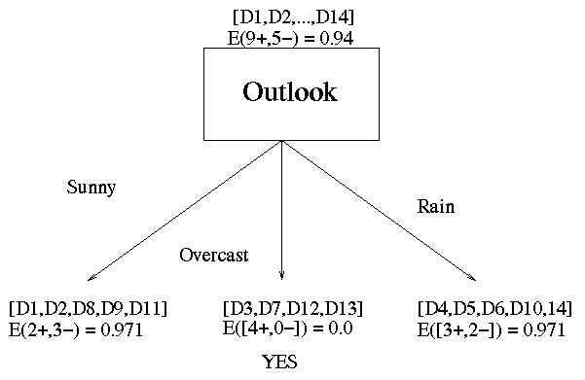
Decision Tree Learning: A Simple Example
Outlook is our winner!

Slide 18
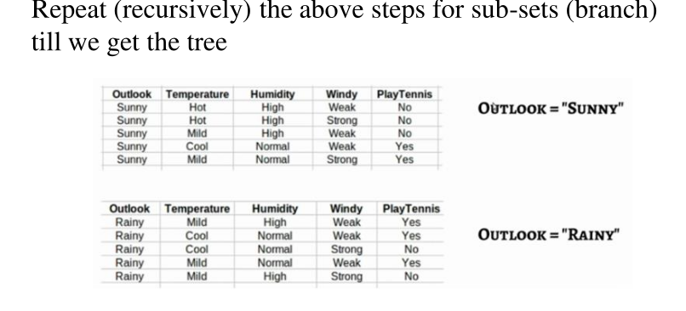
Now that we have discovered the root of our decision tree we must now recursively find the nodes that should go below Sunny, Overcast, and Rain.

Slide 19
If Outlook=Rain is considered next,

Slide 20
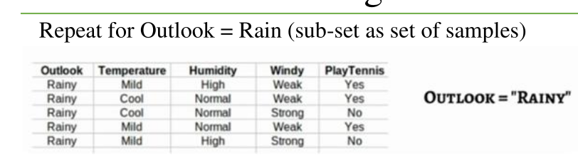
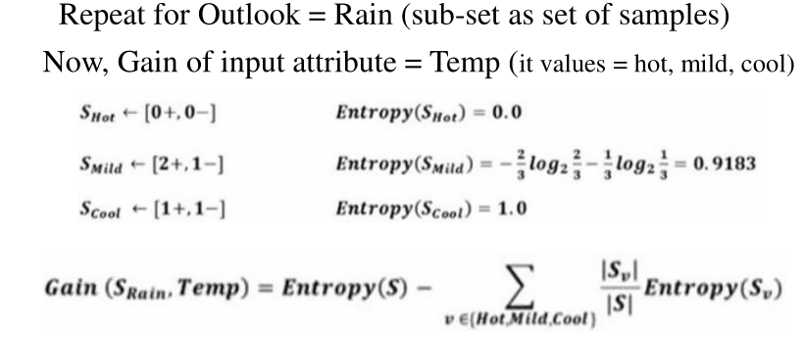
,

Slide 21
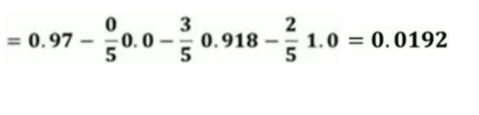
E(S-Rain)=0.971
G(Outlook=Rain, Temperature)= 0.0192.
,

Slide 22
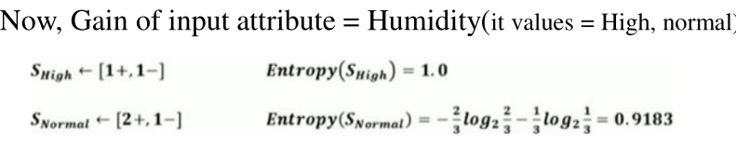
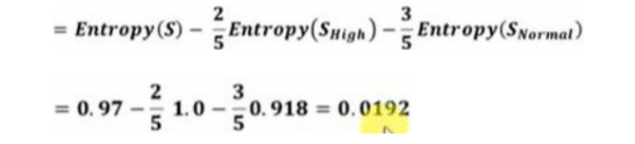
E(S-Rain)=0.971
G(Outlook=Rain, Humidity) = 0.971 – [2/5*E(Outlook=Rain ^ Humidity=high) + 3/5*E(Outlook=Rain ^Humidity=normal]
G(Outlook=Rain, Humidity) = 0.0192
G(Outlook=Rain, Humidity) = 0.0192
,

Slide 23
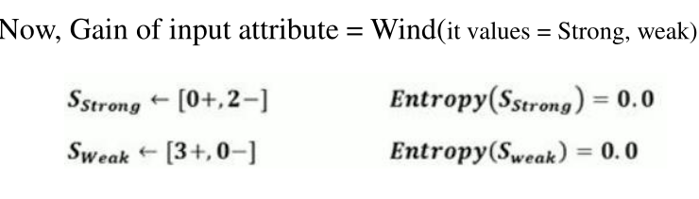
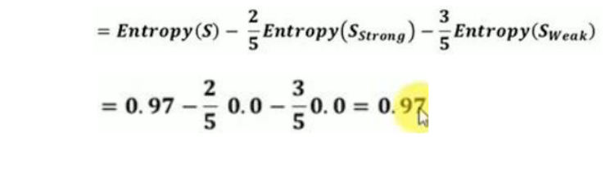
G(Outlook=Rain,Wind) = 0.97
,

Slide 24
Decision Tree Learning: A Simple Example
If Outlook=Rain is considered next, following are the values
G(Outlook=Rain, Humidity) = 0.971 – [2/5*E(Outlook=Rain ^ Humidity=high) + 3/5*E(Outlook=Rain ^Humidity=normal]
G(Outlook=Rain, Humidity) = 0.0192(0.02)
G(Outlook=Rain,Wind) = 0.971- [3/5*0 + 2/5*0]
G(Outlook=Rain,Wind) = 0.971
G(Outlook=Rain, Temperature)= 0.0199.
This value will be less than wind as it is 0.971.

Slide 25
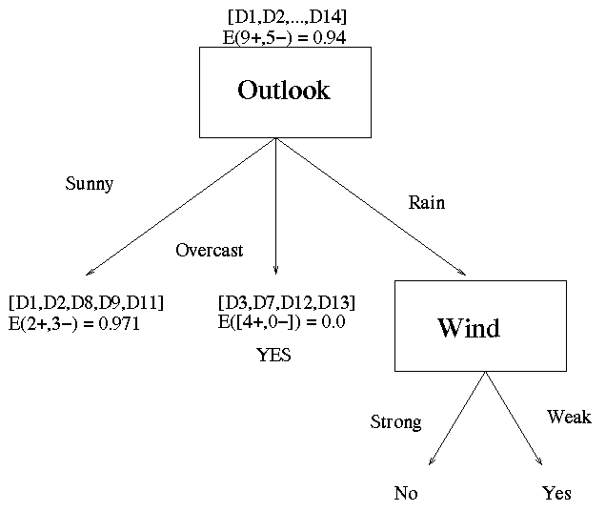
Decision Tree Learning: A Simple Example
Now our decision tree looks like:
D4,D5
D6,D14

Slide 26
If outlook=sunny is considered next, following are the values
[D1,D2,…,D14]
[9+,5-]
Outlook
Sunny
Overcast
Rain
S_{sunny}=[D1,D2,D8,D9,D11]
[2+,3-]
[D3,D7,D12,D13]
[4+,0-]
[D4,D5,D6,D10,D14]
[3+,2-]
?
Yes
?
Gain(S_{sunny} , Humidity)=0.970-(3/5)0.0 – 2/5(0.0) = 0.970
Gain(S_{sunny} , Temp.)=0.970-(2/5)0.0 –2/5(1.0)-(1/5)0.0 = 0.570
Gain(S_{sunny} , Wind)=0.970-(2/5)1.0 – 3/5(0.918) = 0.019
<number>

Slide 27
Outlook
Sunny
Overcast
Rain
Humidity
Yes
Wind
[D3,D7,D12,D13]
High
Normal
Strong
Weak
No
Yes
No
Yes
[D1,D2,D8]
[D9,D11]
[D6,D14]
[D4,D5,D10]
<number>

Slide 28
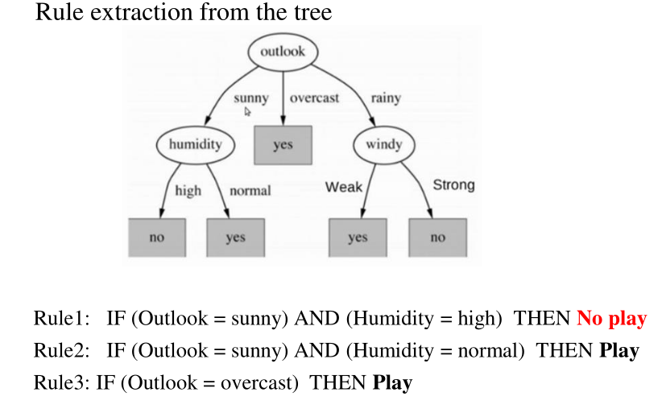

Slide 29
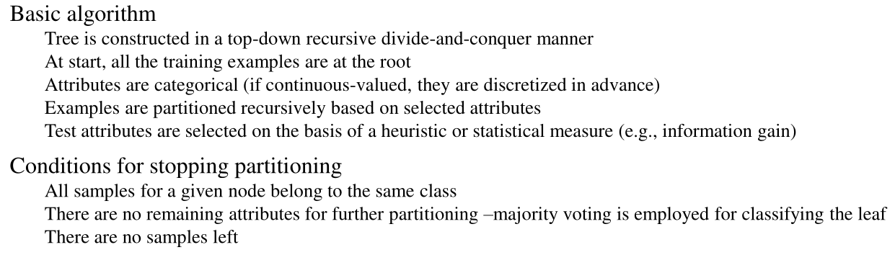

Slide 30
One of the biggest problems with decision trees is Overfitting
-Techniques to avoid overfitting
Pre Pruning
Post Pruning
Gain ratio
Cross validation

Slide 31
Advantages of using ID3
Understandable prediction rules are created from the training data.
Builds the fastest tree.
Builds a short tree.
Only need to test enough attributes until all data is classified.
Finding leaf nodes enables test data to be pruned, reducing number of tests.
Whole dataset is searched to create tree.

Slide 32
Disadvantages of using ID3
Data may be over-fitted or over-classified, if a small sample is tested.
Only one attribute at a time is tested for making a decision.
Classifying continuous data may be computationally expensive, as many trees must be generated to see where to break the continuum.

